Slide 1

Data Structures
Module Number: 1.1
Module Name: Introduction to Data structures
Version: DSA3
Released Date : 2-AUG-2018

Slide 2
Introduction To Data Structures
Introduction to Data structures

Slide 3
Introduction to Data structures
AIM
To learn about different information storage representation

Slide 4
Introduction to Data structures
Objectives:
The Objectives of this module are:
To impart the fundamentals concepts of data structures
To understand concepts about basic storage and its representations
To understand basic concepts about primitive and non-primitive data structures
Learn how data structures are organized in computer
Describe the characteristics of common type of data structures
Understand the concept of Abstract data type

Slide 5
Introduction to Data structures
Outcome:
At the end of this module, you are expected to:
Understand types of storages used in the system
Understand different data structures and related operations
Identify which data structure/ADT will be suitable for the problem at hand and what operations to apply on it to get the problem solved.

Slide 6
Introduction to Data structures
Information and its Storage Representation
Every piece of information stored on computer is encoded as combination of ones and zeros.
These ones and zeros are called bits.
One byte is a sequence of eight consecutive bits.
A word is some number (typically 4) of consecutive bytes.

Slide 7
Introduction to Data structures
Need for Efficient Storage
Secondary memory (disk) is divided into equal-sized blocks.
The basic I/O operation transfers the contents of one disk block to/from main memory.
A disk access is unbelievably expensive compared to a typical computer instruction.
Without efficient data storage structures, a program will spend most of its time retrieving data from secondary storage.
A binary search tree can be ideal for internal data retrievals, but it's performance is inadequate with disk I/O operations.

Slide 8
Introduction to Data structures
Binary representation
A single (unsigned) byte of memory
1
1
1
0
1
0
0
1
bit 7
bit 6
bit 5
bit 4
bit 3
bit 2
bit 1
bit 0
In decimal representation, this number is:
1*2⁰ + 0*2¹ + 0*2² + 1*2³ + 0*2⁴ + 1*2⁵ + 1*2⁶ + 1*2⁷
= 233

Slide 9
Introduction to Data structures
One bit must be used to store sign of number
A single (signed) byte of memory
+/-
1
1
0
1
0
0
1
bit 7
bit 6
bit 5
bit 4
bit 3
bit 2
bit 1
bit 0
In decimal representation, this number is:
1*2⁰ + 0*2¹ + 0*2² + 1*2³ + 0*2⁴ + 1*2⁵ + 1*2⁶
= +/- 105

Slide 10
Introduction to Data structures
Q1. What is the range of numbers that can be stored in a single signed/unsigned byte?
Q2. How would you write a program to convert an arbitrary base 10 number to binary?
Q3. How would you write a program to convert an arbitrary binary number to base 10?
Q4. What is the effect of right/left shifting bits (assuming the lost bit is set to zero)?
Notes:
Hint to Questions:
Answer 1: if 1 byte is used for signed integers, the range of values (in decimal) is -128 to 127; and unsigned integers have the range 0 to 255. If 2 bytes are used to represent signed integers, the range is -32768 to +32767; and 0 to 65535 for unsigned integers.
Answer 2: C program to convert an integer from decimal number system (base-10) to binary number system (base-2). Size of an integer is assumed to be 32 bits. We will use the bitwise operator "AND" to perform the desired task. We right shift the original number by 31, 30, 29, ..., 1, 0 bits using a for loop and bitwise AND the number obtained with 1(one), if the result is 1, then that bit is 1 otherwise it is 0 (zero).
Answer 3: Steps to Solution:
1. Take a binary number as input. 2. Multiply each digits of the binary number starting from the last with the powers of 2 respectively. 3. Add all the multiplied digits. 4. The total sum gives the decimal number.
Answer 4: A bit shift moves each digit in a number's binary representation left or right. The last bit in the direction of the shift is lost, and a 00 bit is inserted on the other end.
0010 << 1 → 0100 1011 >> 1 → 0101
Bit shifts take number of times to shift as the right argument:
1010110 << 2 → 1011000 1011010 >> 3 → 0001011
A single left shift multiplies a binary number by 2:
0010 << 1 → 0100 0010 is 2 0100 is 4
Two left shifts multiplies by 4.
Three left shifts multiplies by 8.
And similarly, shifting right divides by 2, throwing out any remainders.

Slide 11
Introduction to Data structures
Octal Representation
Octal representation: base 8
Just a simple extension of binary and decimal but using only the digits 0-7.
Best seen with an example:
What is the value of the octal number 711?
1*80 + 1*81 + 7*82 = 457
What is the octal representation of the number 64?
100 (since 0*80 + 0*81 + 1*82 = 64)
Try this in C using the "%o" format expression with printf: printf("%o\n", 457);

Slide 12
Introduction to Data structures
Hexadecimal Representation
Hexadecimal representation: base 16
Just a simple extension of binary, octal, and decimal but using 16 "digits": 0-9,a,b,c,d,e,f
Example: What is the value of the hexadecimal number 10ef?
15*160 + 14*161 + 0*162 + 1*163 = 4351
Try this in C using the "%x" format expression with printf: printf("%x\n", 4351);

Slide 13
Introduction to Data structures
Data Types: Introduction
A data type is not just a set of objects. We must consider all operations on these objects. A complete definition of a type must include a list of operations and their definitions.
Primitive data objects are close to hardware, and are represented directly (or almost directly) at the machine level—usually word, byte, bit.

Slide 14
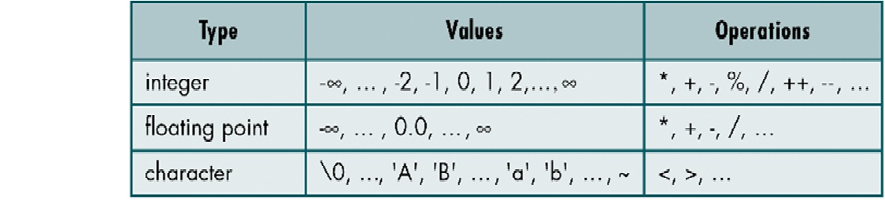
Introduction to Data structures
Understanding data types at a more fundamental level
int and char
Table 1.1.1 : Data types

Slide 15
Introduction to Data structures
Integer Types
An integer type is a finite approximation of the infinite set of integer numbers: {0, 1, -1, 2, -2, ...}.
Various kinds of integers: signed—unsigned, long—short—small.
Hardware implementations of integers: one's complement, two's complement,

Slide 16
Introduction to Data structures
Floating-point Types
All "real" numbers in computers are finite approximations of the non-denumerable set of real numbers.
Precision and range of values are defined by the language or by the programmer.
Hardware implementations (used by floating-point processors): exponent and mantissa.

Slide 17
Introduction to Data structures
Boolean type
This type is not supported by all languages (for example, it is not available in PL/, C, Perl).
The values are true and false. Operations are as in classical two-valued propositional logic.
Hardware implementation: a single bit or a byte (this allows more efficient operations).

Slide 18
Introduction to Data structures
Character types
This is usually ASCII, but extended character (Unicode, ISO) sets are often used.
Accented characters é à ü etc. should fit within ASCII, though there is no single standard.
Chinese or Japanese are examples of writing systems that require character sets of many more than 256 elements.
Hardware implementation: a byte (ASCII, EBCDIC), two bytes (Unicode) or several bytes.

Slide 19
Introduction to Data structures
Other primitive types
word (for example, in Modula-2)
byte, bit (for example, in PL/I)
pointer (for example, in C)

Slide 20
Introduction to Data structures
Structured data types
Points
Strings
Enumerated types
Arrays
Records

Slide 21
Introduction to Data structures
Strings
A string is a sequence of characters. It may be:
a special data type (its objects can be decomposed into characters)—Fortran, Basic;
an array of characters—Pascal, Ada;
a list of characters—Prolog;
consecutively stored characters—C.
The syntax is the same: characters in quotes.
Pascal has one kind of quotes, Ada has two:
'A' is a character, "A" is a string.

Slide 22
Introduction to Data structures
String operations
Typical operations on strings
string × string → string
concatenation
string × int × int → string
substring
string → characters
decompose into an array or list
characters → string
convert an array or list into a string

Slide 23
Introduction to Data structures
string → integer
length
string → boolean
is it empty?
string × string → boolean
equality, ordering

Slide 24
Introduction to Data structures
More string operations…
Specialized string manipulation languages (Snobol, Icon) include built-in pattern matching, sometimes very complicated, with extremely elaborate backtracking.
Another language that works very well with strings is, of course, Perl.

Slide 25
Introduction to Data structures
Fixed- and variable-length strings
The allowed length of strings is a design issue:
fixed-length strings—Pascal, Ada, Fortran;
variable-length strings—C, Java, Perl.
A character may be treated as a string of length 1, or as a separate data structure. Many languages (Pascal, Ada, C, Prolog) treat strings as special cases of arrays or lists.
Operations on strings are the same as on arrays or lists of other types. For example, every character in a character array is available at once, whereas a list of characters must be searched linearly.

Slide 26
Introduction to Data structures
Enumerated types
Also called: user-defined ordinal types We can declare a list of symbolic constants that are to be treated literally, just like in Prolog or Scheme.
We also specify the implicit ordering of those newly introduced symbolic constants. In Pascal:
type day = (mo, tu, we, th, fr, sa, su);
Here, we have mo < tu < we < th < fr < sa < su.

Slide 27
Introduction to Data structures
Operators for Enumerated types
Pascal supplies the programmer with three generic operations for every new enumerated type T:
succ: successor, for example, succ(tu) = we
pred: predecessor, for example, pred(su) = sa
(each is undefined at one end)
ord: (ordinal) position in the type, starting at 0,so for example ord(th) = 3
For characters, Pascal also has char, producing the character at a given position, so for example chr(65) returns ‘A’.

Slide 28
Introduction to Data structures
Char Revisited
We have just a few basic types:
char, int, float, double
The char represents a single byte of storage, while int is typically 4 bytes
Important: Do not be misled by the name "char" ; the char datatype is really no different from int (other than its storage capacity)
What do I mean by "no different from int"? We explore this with some examples on the next slide.

Slide 29
Introduction to Data structures
Why would you not always use char to represent a smaller number, such as 4?
Consider what happens in this case:
char j = 4;
j = j + 300; /* bad! Can't store 304 in a char!
So, it is safer to use a larger type, such as int, unless you are 100% sure that the char limit will never be exceeded in the program!

Slide 30
Introduction to Data structures
Char as "character" storage
So, if char is just an abbreviated int, what does it have to do with characters?
The answer is twofold:
First, char can do nothing special with characters that int can't do.
Both store equivalent ASCII integer code when single quotes are placed around a single character in an assignment.
Example:
char c = 'e'; /* store the integer (ASCII) code for the character e in the byte c */
Int c = 'e'; /* same as above, but store integer in 4-byte (ie int) sequence.

Slide 31
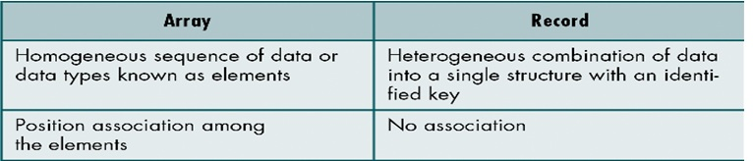
Introduction to Data structures
Data Structures
Aggregation of atomic and composite data into a set with defined relationships. Structure refers to a set of rules that hold the data together.
A combination of elements in which each is either a data type or another data structure.
A set of associations of relationship involving combined elements.
Example:
Table 1.1.2: Difference between Array and Record

Slide 32
Introduction to Data structures
Classification of Data Structure
Non-Primitive DS
Linear List
Non-Linear List
Array
Queue
Graph
Trees
Link List
Stack
Figure 1.1.1: Types of Data Structure

Slide 33
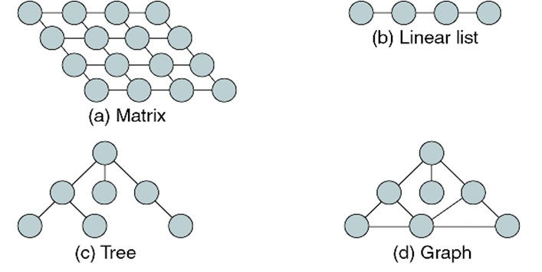
Introduction to Data structures
Some Data Structures
Figure 1.1.2 : Data Structure Examples

Slide 34
Introduction to Data structures
Abstract Data Type
ADT users are NOT concerned with how the task is done but rather what it can do.
An abstract data type is a data declaration packaged together with the operations that are meaningful for the data type.
We encapsulate the data and the operations on the data, and then hide them from the user.
All references to and manipulation of the data in a data structure are handled through defined interfaces to the structure.

Slide 35
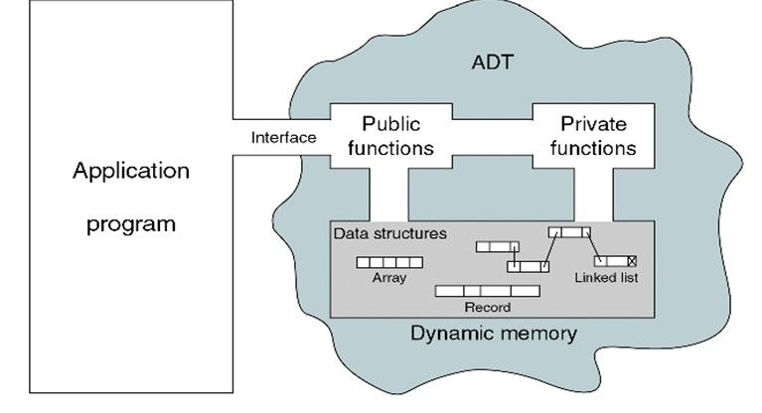
Introduction to Data structures
Model for an Abstract Data Type
Figure 1.1.3: Abstract Data Type Model
Notes:
As illustrated in Fig 1.1.3, an abstract data type (ADT) is a mathematical model for data types, where a data type is defined by its behavior (semantics) from the point of view of a user of the data, specifically in terms of possible values, possible operations on data of this type, and the behavior of these operations. This contrasts with data structures, which are concrete representations of data, and are the point of view of an implementer, not a user.
For example, integers are an ADT, defined as the values …, −2, −1, 0, 1, 2, …, and by the operations of addition, subtraction, multiplication, and division, together with greater than, less than, etc., which behave according to familiar mathematics (with care for integer division), independently of how the integers are represented by the computer. Explicitly, "behavior" includes obeying various axioms (associativity and commutativity of addition etc.), and preconditions on operations (cannot divide by zero). Typically integers are represented in a data structure as binary numbers, most often as two's complement, but might be binary-coded decimal or in ones' complement, but the user is abstracted from the concrete choice of representation, and can simply use the data as data types.
An ADT consists not only of operations, but also of values of the underlying data and of constraints on the operations. An "interface" typically refers only to the operations, and perhaps some of the constraints on the operations, notably pre-conditions and post-conditions, but not other constraints, such as relations between the operations.
For example, an abstract stack, which is a last-in-first-out structure, could be defined by three operations: push, that inserts a data item onto the stack; pop, that removes a data item from it; and peek or top, that accesses a data item on top of the stack without removal. An abstract queue, which is a first-in-first-out structure, would also have three operations: enqueue, that inserts a data item into the queue; dequeue, that removes the first data item from it; and front, that accesses and serves the first data item in the queue. There would be no way of differentiating these two data types, unless a mathematical constraint is introduced that for a stack specifies that each pop always returns the most recently pushed item that has not been popped yet. When analyzing the efficiency of algorithms that use stacks, one may also specify that all operations take the same time no matter how many data items have been pushed into the stack, and that the stack uses a constant amount of storage for each element.

Slide 36
Introduction to Data structures
Primitive data structures
Primitive data structures are basic structures and are directly operated upon by machine instructions.
->Integers, float, character and pointers are examples.
-> integer- stores the numbers without the fractional part.
-> float- stores the fractional number.
-> Characters- used for storing the character values. -> pointer- which stores the address of another variable.

Slide 37
Introduction to Data structures
There are basic structures and directly operated upon by the machine instructions.
In general, there are different representation on different computers.
Integer, Floating-point number, Character constants, string constants, pointers etc. fall in this category.

Slide 38
Introduction to Data structures
Non-Primitive data structures
There are more sophisticated data structures.
These are derived from the primitive data structures.
The non-primitive data structures emphasize on structuring of a group of homogeneous (same type) or heterogeneous (different type) data items.
Lists, Stack, Queue, Tree, Graph are example of non-primitive data structures.
The design of an efficient data structure must take operations to be performed on the data structure.

Slide 39
Introduction to Data structures
The most commonly used operation on data structure are broadly categorized into following types:
Create
Selection
Updating
Searching
Sorting
Merging
Destroy or Delete

Slide 40
Introduction to Data structures
Difference between them
A primitive data structure is generally a basic structure that is usually built into the language, such as an integer, a float etc.
A non-primitive data structure is built out of primitive data structures linked together in meaningful ways, such as a linked-list, binary search tree, AVL Tree, graph etc.

Slide 41
Introduction to Data structures
Linear Data Structures and Sequential storage Representation
A data structure is said to be linear if the elements in each and every node of a list are in a systematic manner.
The linear data structures are single level data structures.
A linear data structure traverses the data elements sequentially. They store the data in the form of a list.
Example: Arrays, Stack, Queue, Linked List
The storage format of the data in the memory in which the data is arranged are in contiguous blocks of memory.

Slide 42
Introduction to Data structures
Description of various Data Structures : Arrays
An array is defined as a set of finite number of homogeneous elements or same data items.
It means an array can contain one type of data only, either all integer, all float-point number or all character.

Slide 43
Introduction to Data structures
Arrays
Simply, declaration of array is as follows:
int arr[10]
Where int specifies the data type or type of elements arrays stores.
“arr” is the name of array & the number specified inside the square brackets is the number of elements an array can store, this is also called sized or length of array.

Slide 44
Introduction to Data structures
Following are some of the concepts to be remembered about arrays:
The individual element of an array can be accessed by specifying name of the array, following by index or subscript inside square brackets.
The first element of the array has index zero[0]. It means the first element and last element will be specified as:arr[0] & arr[9] Respectively.
The elements of array will always be stored in the consecutive (continues) memory location.
The number of elements that can be stored in an array, that is the size of array or its length is given by the following equation:
(Upperbound-lowerbound)+1

Slide 45
Introduction to Data structures
For the above array it would be
(9-0)+1=10, where 0 is the lower bound of array and 9 is the upper bound of array.
Array can always be read or written through loop. If we read a one-dimensional array it requires one loop for reading and the other for writing the array.
For example: Reading an array
For(i=0;i<=9;i++)
scanf(“%d”,&arr[i]);
For example: Writing an array
For(i=0;i<=9;i++)
printf(“%d”,arr[i]);

Slide 46
Introduction to Data structures
If we are reading or writing two-dimensional array, it would require two loops. And similarly the array of a N dimension would required N loops.
Some common operation performed on array are:
Creation of an array
Traversing an array
Insertion of new element
Deletion of required element
Modification of an element
Merging of arrays

Slide 47
Introduction to Data structures
Application of Arrays:
Arrays are used to retrieve and use JavaScript in the web browser to process that information. So basically, databases are used to store data for a long period of time, and an array to process data temporarily.
Whenever we need to keep track of an ordered list of items, array are used : a list of songs, a list of each keystroke a user clicks. Even in the JSON data format, we often use an array to hold a list of objects.

Slide 48
Introduction to Data structures
Lists
A list (Linear linked list) can be defined as a collection of variable number of data items.
Lists are the most commonly used non-primitive data structures.
An element of list must contain at least two fields, one for storing data or information and other for storing address of next element.
As you know, for storing address, we have a special data structure of list, the address must be pointer type.

Slide 49

Introduction to Data structures
Real Life Examples of Linked Lists
A simple real life example is a Train, here each coach is connected to its previous and next coach (Except first and last). In terms of programming consider coach body as node value and connectors as links to previous and next nodes.
HEAD
NODE
TAIL NODE
Figure 1.1.4: Real Life example of Train

Slide 50
Introduction to Data structures
USE CASES
Consider the history section of web browsers, where it creates a linked list of web-pages visited, so that when you check history (traversal of a list) or press back button, the previous node's data is fetched.
One common sighted example is low level memory management (i.e. the heap as managed by malloc in C or new in Java, etc) is often implemented as a linked list, with each node representing a used or available (free) block of memory. These blocks may be of any size, change size (combine and split), be freed or assigned in any order, and reordered. A linked list means you can keep track of all of these "nodes" and manipulate them fairly easily.
Also, Hash tables that use chaining to resolve hash collisions typically have one linked list per bucket for the elements in that bucket.

Slide 51
Introduction to Data structures
Technically each such element is referred to as a node, therefore a list can be defined as a collection of nodes as show bellow:
Linear Liked List
Head
AAA
BBB
CCC
Information field
Pointer field
Figure 1.1.5: Schematic representation of Singly Linked List

Slide 52
Introduction to Data structures
Types of linked lists:
Single linked list
Doubly linked list
Single circular linked list
Doubly circular linked list

Slide 53
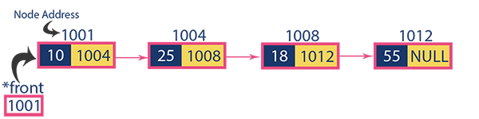
Introduction to Data structures
Single linked list
Figure 1.1.6: Example of Singly Linked List
In a single linked list we perform the following operations:
Insertion
Deletion
Display

Slide 54
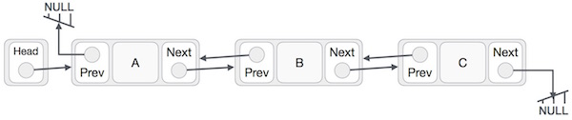
Introduction to Data structures
Doubly linked list
Figure 1.1.7: Example of Doubly Linked List
Following are the basic operations supported by a list.
Insertion
Deletion
Display forward
Display backward
Notes:
As per the above illustration, following are the important points to be considered.
Doubly Linked List contains a link element called first and last.
Each link carries a data field(s) and two link fields called next and prev.
Each link is linked with its next link using its next link.
Each link is linked with its previous link using its previous link.
The last link carries a link as null to mark the end of the list.

Slide 55

Introduction to Data structures
Single circular linked list
Figure 1.1.8: Example of Single Circular Linked List
Following are the important operations supported by a circular list.
insert − Inserts an element at the start of the list.
delete − Deletes an element from the start of the list.
display − Displays the list.

Slide 56

Introduction to Data structures
Doubly circular linked list
Figure 1.1.9: Example of Doubly Circular Linked List
Following are the important operations supported by a circular list.
insert − Inserts an element at the start of the list.
delete − Deletes an element from the start of the list.
display − Displays the list.

Slide 57
Introduction to Data structures
Stack
A stack is also an ordered collection of elements like arrays, but it has a special feature that deletion and insertion of elements can be done only from one end called the top of the stack (TOP).
Due to this property it is also called as last in first out type of data structure (LIFO).
It could be through a stack of plates placed on table in a party, a guest always takes off a fresh plate from the top and the new plates are placed on to the stack at the top.
It is a non-primitive data structure.
When an element is inserted into a stack or removed from the stack, its base remains fixed where the top of stack changes.

Slide 58
Introduction to Data structures
Insertion of element into stack is called PUSH and deletion of element from stack is called POP.
The below figure shows how the operations take place on a stack:
PUSH
POP
[STACK]
Figure 1.1.10: Schematic representation of stack

Slide 59
Introduction to Data structures
The stack can be implemented into two ways:
Using arrays (Static implementation)
Using pointer (Dynamic implementation)

Slide 60
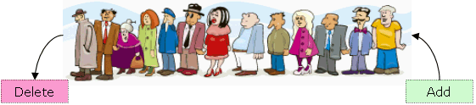
Introduction to Data structures
Queue
Queue are first in first out type of data structure (i.e. FIFO)
Source: http://www.equestionanswers.com
Figure 1.1.11: Reservation Line for ticket Source: http://www.equestionanswers.com

Slide 61
Introduction to Data structures
Queue
Queue are first in first out type of data structure (i.e. FIFO)
In a queue, new elements are added to the queue from one end called REAR end, and the element are always removed from other end called the FRONT end.
The people standing in a railway reservation row are an example of queue.
Each new person comes and stands at the end of the row and person getting their reservation confirmed get out of the row from the front end.

Slide 62
Introduction to Data structures
The bellow show figure how the operations take place on a Queue:
10 | 20 | 30 | 40 | 50
front
rear
Figure 1.1.12: Schematic representation of Queue

Slide 63
Introduction to Data structures
The queue can be implemented into two ways:
Using arrays (Static implementation)
Using pointer (Dynamic implementation)

Slide 64
Introduction to Data structures
Queue implementation using arrays (Static implementation)
Following operations may be performed:
Create
Enqueue
Dequeue
Is_Empty
Is_Full
Display
Notes:
Note: This implementation is called static implementation as the size of queue has to be known at compile time

Slide 65
Introduction to Data structures
Create Operation
First step in implementing the queue using arrays is to create a empty queue.
Following steps are to be performed:
Step 1: Create a one dimensional array with defined SIZE (int queue[SIZE])
Step 2: Define two integer variables 'front' and 'rear' and initialize both with '-1'. (int front = -1, rear = -1)
Front = -1
Rear = -1
Index Values
0
1
2
………..
SIZE -1
Figure 1.1.13: Creating Queue using Array

Slide 66
Introduction to Data structures
Dequeue Operation
The following steps should be taken to dequeue (delete) data from a queue −
Step 1 − Check if the queue is empty using Is_Empty operations.
Step 2 − If the queue is empty, produce underflow error and exit.
Step 3 − If the queue is not empty, access the data where front is pointing.
Step 4 − Put Null where front is pointing and increment front pointer to point to the next available data element.
Step 5 − Return success.
Dequeue
16
-32
10
9
NULL
-32
10
9
Index Values
0
1
2
3
4
5
6
0
1
2
3
4
5
6
Front
Rear
Front
Rear
Figure 1.1.14: Dequeue Operation
Notes:
Note: Is_Empty operations checks whether array is Empty or not and returns True or False value

Slide 67
Introduction to Data structures
Enqueue Operation
The following steps should be taken to enqueue (insert) data into a queue −
Step 1 − Check if the queue is full by using Is_Full operation.
Step 2 − If the queue is full, produce overflow error and exit.
Step 3 − If the queue is not full, increment rear pointer to point the next empty space.
Step 4 − Add data element to the queue location, where the rear is pointing.
Step 5 − return success.
Enqueue (25)
16
-32
10
9
16
-32
10
9
25
Index Values
0
1
2
3
4
5
6
0
1
2
3
4
5
6
Front
Rear
Front
Rear
Figure 1.1.15: Enqueue Operation
Notes:
Note: Is_Full operations checks whether array is Full or not and returns True or False value

Slide 68
Introduction to Data structures
Queue implementation using Linked List (Dynamic implementation)
Following operations may be performed:
Create
Enqueue
Dequeue
Display
Notes:
Note: This implementation is called dynamic implementation as the size of queue may be increased during run time

Slide 69
Introduction to Data structures
Enqueue operation on Queue (implemented using Linked List)
After Enqueue operation ( Example value 89 is inserted )
56
95
322
NULL
Node Value
678
322
23
NULL
Node Address
3115
678
322
Link/pointer to next Node
Rear
Front
Node Value
56
678
95
322
23
119
89
NULL
Node Address
3115
678
322
119
Link/pointer to next Node
Front
Figure 1.1.16: Enqueue Operation on Queue using Linked List
Rear
Notes:
In Enqueue operation following steps are performed
Step 1: New Node is created
Step 2: Value to be inserted is stored in New Node
Step 3: Link part of this node is assigned NULL
Step 4: This Node is inserted to the Queue at the end.
Step 5: Rear pointer updated to the Last Node

Slide 70
Introduction to Data structures
Dequeue operation on Queue (implemented using Linked List)
After Dequeue operation
Node Value
56
95
322
23
NULL
678
322
NULL
Node Address
3115
678
322
Link/pointer to next Node
Rear
Front
Node Value
56
NULL
95
322
23
NULL
Node Address
3115
678
322
Link/pointer to next Node
Front
Rear
Figure 1.1.17: Dequeue Operation on Queue using Linked List
Notes:
In Dequeue operation following steps are performed
Step 1: Queue is checked for Is_Empty
Step 2: If Queue is Empty then output underflow error and exit else go to step 3
Step 3: Store the address in Front pointer to Temp pointer
Step 4: Update Front pointer by assigning it address in the Link part of Node Front is pointing (Front= Front->Link)
Step 5: Free Temp pointer

Slide 71
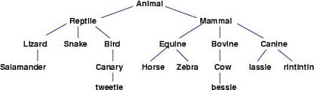
Introduction to Data structures
Trees
Tree is a non-linear data structure used to represent entities having hierarchical relationships
Source: http://people.cs.ksu.edu
Figure 1.1.18: Tree of species, from zoology Source: http://people.cs.ksu.edu
Notes:
Example of Trees in real life:
Family Tree
Table of contents in a book
Class inheritance in OOPs
Organizational hierarchical order
Computer File System

Slide 72
Introduction to Data structures
Trees
There is a special data item at the top of hierarchy called the Root of the tree.
The remaining data items are partitioned into a number of mutually exclusive subset, each of which is itself, a tree which is called the sub tree.
The tree always grows in length towards bottom in data structures, unlike natural trees which grows upwards.

Slide 73
Introduction to Data structures
The tree structure organizes the data into branches, which relates the information.
A
root
B
C
D
E
F
G
Figure 1.1.19: Tree Structure

Slide 74
Introduction to Data structures
Graph
Graph is a mathematical non-linear data structure capable of representing many kind of physical structures.
It has found application in Geography, Chemistry and Engineering sciences.
Definition: A graph G (V, E) is a set of vertices V and a set of edges E.
An edge connects a pair of vertices and many have weight such as length, cost and another measuring instrument for according the graph.
Vertices on the graph are shown as point or circles and edges are drawn as arcs or line segment.

Slide 75
Introduction to Data structures
Types of Graphs:
Directed graph
Undirected graph
Simple graph
Weighted graph
Connected graph
Non-connected graph

Slide 76
Introduction to Data structures
Directed graph Vs Undirected graph
For a graph G = (V, E)
undirected if for all
v, w ∈ V : (v, w) ∈ E ⇐⇒ (w, v) ∈ E.
Otherwise directed.
Example of Directed Graph :
Airline route maps.
Vertices represent airports, and there is an edge from vertex A to vertex B if there is a direct flight from
the airport represented by A to the airport represented by B.

Slide 77
Introduction to Data structures
Example of graph:
v2
v5
v1
v3
v1
v3
v4
v2
v4
[a] Directed Graph
[b] Undirected Graph
Figure 1.1.20: Directed and Undirected Graphs

Slide 78
Introduction to Data structures
Weighted graph
In many applications, each edge of a graph has an associated numerical value, called a weight.
Usually, the edge weights are nonnegative integers.
Weighted graphs may be either directed or undirected.
The weight of an edge is often referred to as the "cost" of the edge.
In applications, the weight may be a measure of the length of a route, the capacity of a line, the energy required to move between locations along a route, etc.

Slide 79
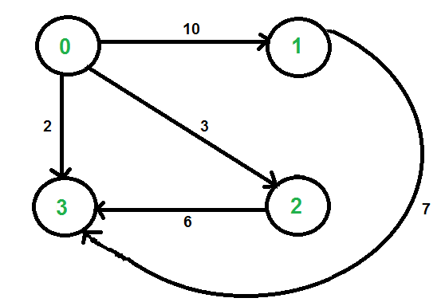
Introduction to Data structures
Example of Weighted graph
Figure 1.1.21: Weighted Graph

Slide 80
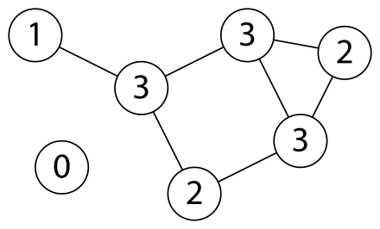
Introduction to Data structures
Connected Vs Non Connected graph
A graph is connected when there is a path between every pair of vertices. In a connected graph, there are no unreachable vertices. A graph that is not connected is disconnected. A graph G is said to be disconnected if there exist two nodes in G such that no path in G has those nodes as endpoints.
a) Connected Graph
b) Disconnected Graph
Figure 1.1.22: Connected and Disconnected Graphs

Slide 81
Introduction to Data structures
Operations on Data structures
Insertion: It reserves the memory for program elements. It may take place either during compile-time or run-time.
Deletion: It destroys memory space allocated for specified data structure.
Selection: It deals with accessing a particular data within a data structure.
Searching: It finds the presence of desired data item in the list of data items.
Sorting: Arranges all data items in a data structure in a particular order.
Merging: It is the process of combining the data items of two different sorted list into a single sorted list.
Traversal: Process of vising each and every node of a list in a systematic manner.

Slide 82
Introduction to Data structures
Assignment
Q1. Which of these best describes an array? a) A data structure that shows a hierarchical behavior b) Container of objects of similar types c) Container of objects of mixed types d) All of the mentioned
Q2. Assuming int is of 4bytes, what is the size of int arr[15];? a) 15 b) 19 c) 11 d) 60
Q3. In a stack, if a user tries to remove an element from empty stack it is called _________ a) Underflow b) Empty collection c) Overflow d) Garbage Collection
Q4. Which of the following applications may use a stack? a) A parentheses balancing program b) Tracking of local variables at run time c) Compiler Syntax Analyzer d) All of the mentioned
Notes:
Answer1: b)
Answer2: d)
Answer3: a)
Answer4: d)

Slide 83
Introduction to Data structures
Assignment
Q5. A linear list of elements in which deletion can be done from one end (front) and insertion can take place only at the other end (rear) is known as a ? a) Queue b) Stack c) Tree d) Linked list
Q6. A data structure in which elements can be inserted or deleted at/from both the ends but not in the middle is? a) Queue b) Circular queue c) Dequeue d) Priority queue
Q7. The data structure required for Breadth First Traversal on a graph is? a) Stack b) Array c) Queue d) Tree
Q8. A graph having an edge from each vertex to every other vertex is called a ___________ a) Tightly Connected b) Strongly Connected c) Weakly Connected d) Loosely Connected
Notes:
Answer5: a)
Answer6: c)
Answer7: c)
Answer8: a)
Answer3: a)
Answer4: d)

Slide 84
Introduction to Data structures
Concepts and Terminology for Non-primitive Data Structures
The non-linear data structures are multi-level data structures.
Example: Tree
They are having a hierarchical relationship among its elements called nodes.
Topmost nodes is called root of the tree and the bottommost nodes are called leaves of the tree.
Each of the nodes have some pointers, pointing to the nodes below it.
Binary tree is the special type of tree where each nodes has two pointers, one pointing to the left node and the other pointing to its right node.

Slide 85
Introduction to Data structures
Sparse Matrix Manipulation
A matrix is a two-dimensional data object made of m rows and n columns, therefore having total m x n values. If most of the elements of the matrix have 0 value, then it is called a sparse matrix.
Why to use Sparse Matrix instead of simple matrix ?
Storage: There are lesser non-zero elements than zeros and thus lesser memory can be used to store only those elements.
Computing time: Computing time can be saved by logically designing a data structure traversing only non-zero elements.

Slide 86
Introduction to Data structures
The sparse matrix ADT
The standard representation of a matrix is a two dimensional array defined as
a[MAX_ROWS][MAX_COLS].
We can quickly locate any element by writing a[ i ][ j ]
Sparse matrix wastes space.
We must consider alternate forms of representation.
Our representation of sparse matrices should store only non-zero elements.
Each element is characterized by <row, col, value>.

Slide 87
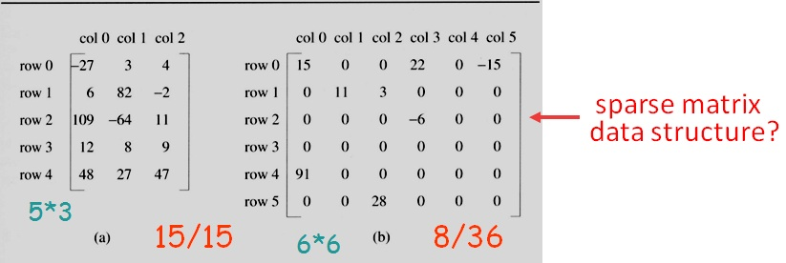
Introduction to Data structures
The sparse matrix ADT
In mathematics, a matrix contains m rows and n columns of elements, we write m x n to designate a matrix with m rows and n columns.
Figure 1.1.23: Example of Simple and Sparse Matrix

Slide 88
Introduction to Data structures
The sparse matrix ADT
Sparse Matrix is either structured or unstructured

Slide 89
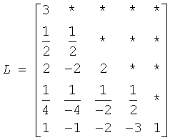
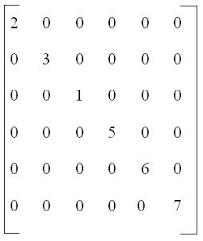
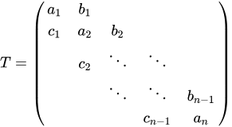
Introduction to Data structures
The sparse matrix ADT
Structured sparse matrix
a) Diagonal
b) Tridiagonal
c) Lower Triangular
Figure 1.1.24: Example of Structured sparse matrix

Slide 90
Introduction to Data structures
The sparse matrix ADT
Structured sparse matrix:
May be mapped into a 1D array so that a mapping function can be used to locate an element.

Slide 91
Introduction to Data structures
The sparse matrix ADT
Unstructured sparse matrix
Example:
Airline flight matrix.
airports are numbered 1 through n
flight(i,j) = list of nonstop flights from airport i to airport j
n = 1000 (say)
n x n array of list references => 4 million bytes
total number of flights = 20,000 (say)
need at most 20,000 list references => at most 80,000 bytes
Notes:
Assume that flight(i,j) = null if there is no flight from i to j. Of the 1 million entries in the flight matrix at most 20,000 can be not null as each not null entry represents at least 1 different flight. So we need to store at most 20,000 not null entries.

Slide 92
Introduction to Data structures
The sparse matrix ADT
Representation of unstructured sparse matrix
Single linear list in row-major order.
scan the nonzero elements of the sparse matrix in row-major order
each nonzero element is represented by a triple (row, column, value)
the list of triples may be an array list or a linked list (chain)

Slide 93
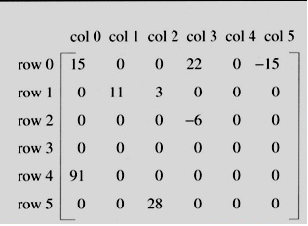
Introduction to Data structures
The sparse matrix ADT
Representation of unstructured sparse matrix as single linear list in row-major order.
Figure 1.1.25 shows how the sparse matrix is represented in the array A[].
Represented by a two-dimensional array.
Each element is characterized by <row, col, value>.
Index | row | col | value
A[0] | 0 | 0 | 15
[1] | 0 | 3 | 22
[2] | 0 | 5 | -15
[3] | 1 | 1 | 11
[4] | 1 | 2 | 3
[5] | 2 | 3 | -6
[6] | 4 | 0 | 91
[7] | 5 | 2 | 28
Figure 1.1.25: Sparse Matrix representation as an Array

Slide 94
Introduction to Data structures
The sparse matrix ADT
Representation of unstructured sparse matrix as single chain.
Figure shows how the sparse matrix is represented as single chain using Linked List.
Index | row | col | value
A[0] | 0 | 0 | 15
[1] | 0 | 3 | 22
[2] | 0 | 5 | -15
[3] | 1 | 1 | 11
[4] | 1 | 2 | 3
[5] | 2 | 3 | -6
[6] | 4 | 0 | 91
[7] | 5 | 2 | 28
row
col
Node structure for Linked List
value
next
0
0
0
3
0
5
1
1
1
2
2
3
4
0
5
2
15
22
-15
11
3
-6
91
28
NULL
Head Node
Figure 1.1.26: Sparse Matrix representation as an Single Chain using Linked List

Slide 95

Introduction to Data structures
Polynomial Representation and Manipulation
A polynomial is an expression that contains more than two terms. A term is made up of coefficient and exponent. An example of polynomial is:
P(x) = 4x3+6x2+7x+9
A polynomial thus may be represented using arrays or linked lists.
Figure 1.1.27: Array representation of polynomial

Slide 96

Introduction to Data structures
Polynomial Manipulation
A polynomial may also be represented using a linked list. The structure definition may be given as shown below:
struct polynomial { int coefficient; int exponent; struct polynomial *next; };
Figure 1.1.28: Linked List representation of polynomial

Slide 97
Introduction to Data structures
Self Assessment Questions
Collection of ones and zeros are called …………….
bytes
bits
word
None of the above
Answer: b)
Notes:
b)

Slide 98
Introduction to Data structures
2. A linear data structures are…………….level structure
single
Two level
multiple
None of the above
Answer: a)
Notes:
2. a)

Slide 99
Introduction to Data structures
3. Example for linear data structure…………….
array
Tree
Graph
None of the above
Answer: a)
Notes:
3. a)

Slide 100
Introduction to Data structures
Document Links
TOPICS | URL | Notes
Primitive data structures | https://www2.southeastern.edu/Academics/Faculty/kyang/2008/Fall/CMPS161/ClassNotes/CMPS161ClassNotesChap02.pdf | Fundamental concepts of data structures, features and organisations
Basic data types | http://www.darshan.ac.in/Upload/DIET/Documents/CE/2130702_DS_2015_24112015_025019AM.pdf | This links explains different basic data types.
Operations on data structures | https://www.tutorialspoint.com/data_structures_algorithms/data_structures_algorithms_tutorial.pdf | This link contains the operations of data structures

Slide 101
Introduction to Data structures
Video Links
TOPICS | URL | Notes
Primitive data structures | https://study.com/academy/lesson/non-primitive-data-types-in-java.html | This link explain the Memory allocation of array
Basic data types | https://www.youtube.com/watch?v=YWnBbNj_G-U | This links explains different basic data types.
Operations on data structures | https://www.youtube.com/watch?v=YWnBbNj_G-U | This link contains the operations of data structures

